Slide 1


Build your own gas turbine performance model in Python
Tutorial of Basics
ASME IGTI TE 2025 Aircraft Engine Committee
Dr. Wilfried Visser
Oscar Kogenhop MSc

Slide 2
Overview
Introduction
System performance modelling
Propulsion and power systems
Software implementation
Case study: jet engine python model
Concluding remarks

Slide 3
For whom is this tutorial
Introduction
Engineers, scientists, researchers, students
With interest in system simulation of propulsion and power systems
Wanting to learn how system models work
Needing for models with new functionalities
Coupling with other models
Having basic coding skills

Slide 4
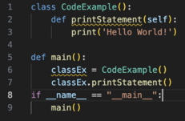
Key focus areas
Introduction
System model basic elements
Object orientation
Python programming language
Open-source libraries
Aero-thermal
Numerical methods
Data handling
Visualization

Slide 5
System performance modeling
System of interacting components
Relationships among system of interacting components
Component models
Equations
conservation of mass, energy, momentum, other…
mostly non-linear algebraic/differential
Component operating points
Defined by state variables
Solution of set of equations
State variable vector representing valid system operating point
Steady-state or transient

Slide 6
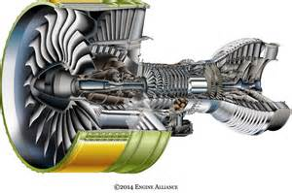
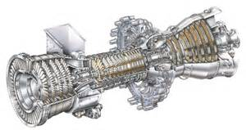
Propulsion and power systems
System performance modeling
Gas turbines
Aero engines: jet engines, turboprop, turboshaft
Land based engines: turboshaft
Propellers and rotors
Hybrid elements
Electric motors
Generators
Fuel cells
Batteries
Alternative/sustainable fuels

Slide 7

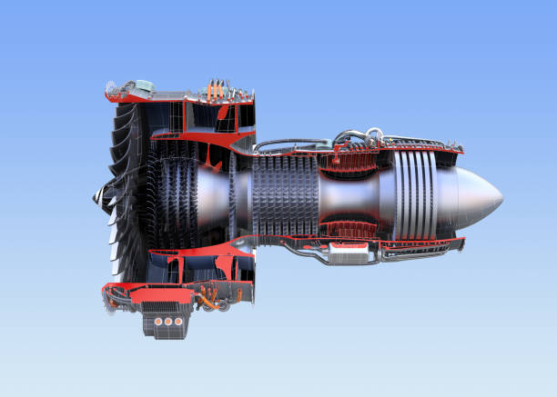
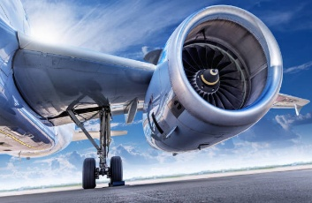
Propulsion and power system performance prediction
System performance modeling
Design studies
Existing designs

Slide 8
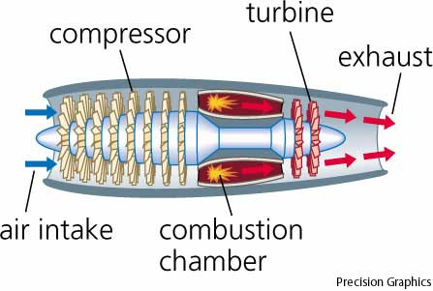
Gas turbine system performance models
System performance modeling
Components models
intake, fans/compressors, combustors, turbines, mixers, exhausts,
Component maps
State variables
Rotor speeds, mass flows, pressure ratios, …
Equations
Mass flow in = mass flow out (at component intersections, engine stations)
Power balance : PWcompressor = PWturbine
Input
Fuel flow, TIT, inlet P and T…
Output
Thrust FN, Power, Fuel flow, Efficiency, P, T at engine stations…

Slide 9
Design versus off-design simulation
System performance modeling

Slide 10
Equations and numerical methods
System performance modeling

Slide 11

New propulsion system model elements
System performance modeling
Sustainable fuels
Electric systems
Heat exchangers
Hybrid systems (gas turbines, fuel cells, batteries)
Generators, Electric motors driving fans and propellers
So, there is a need for
Extensions in modeling and simulation tools
Or, build tools from scratch ?

Slide 12

From scratch ?
System performance modeling
Things to think about
Why from scratch?
Will others use my code?
Will code be used later?
For other propulsion systems / engines?
Flexibility
Costs / Benefits of making the tool generic?
Add a user-friendly GUI?
?...
Save time and $ preparing your project
Select language, development platform
Design software architecture

Slide 13
Why from scratch?
System performance modeling
Pros
Full control and flexibility
“I know what I am doing”
Coupling with other models (1..4 D models)
Cons
A lot of work
Validation
Code maintenance / documentation
Code accessibility / readability to others
Especially ‘if you leave the company’

Slide 14

Software implementation
So, you have decided to start
from scratch!

Slide 15
Language / development environment
Software implementation
Python
Open-source programming language/development environment
Widely used by students, young engineers and scientists
Ready to use libraries for almost any engineering problem
Object orientation
Readable code
Development environments
Microsoft Visual Studio Code (‘VS Code’)
PyCharm
Platform? Windows, Linux, IOS?

Slide 16
Python versus previous experience
Software implementation
Gas turbine Simulation Program GSP
Developed at
Dutch National Aerospace Center NLR
Delft University of Technology
Object oriented, GUI
4GL development environment, 30 year legacy code
~120,000 lines of code (excluding library code)
Python “GSPy”
using open-source libraries
~ 1000 - 4000 lines of code !!!!

Slide 17
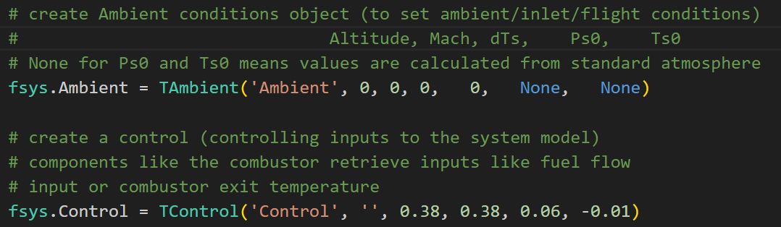
Worling with Python models
Software implementation
Run code from development environment (no GUI)
Specify input in code
Example: specify Ambient conditions and a number of fuel flow steps
Adapt / extend code where needed

Slide 18
Python models overview
Software implementation
Main program
Object oriented architecture
Using open-source libraries
Component model implementations
Output of simulation results

Slide 19
Main program
Software implementation

Slide 20
Object oriented architecture
Software implementation

Slide 21
Python open-source libraries
Software implementation
Ready to use libraries
Standard atmosphere aero-calc
Thermodynamics cantera
Compression, expansion in compressors, turbine, exhausts, nozzles
Combustion chemical reactor model
Multidimensional arrays numpy
Numerical methods scipy
‘root’ generic solver (‘Krylov’ method)
Output data export
Export to .csv pandas
Make graphs in Excel

Slide 22
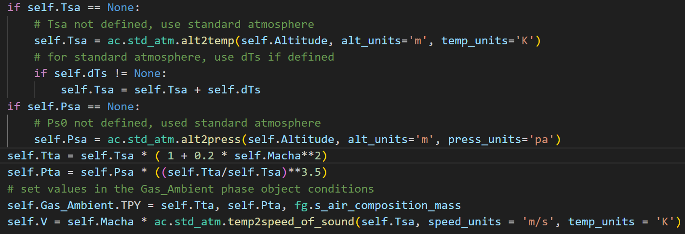
Aero-calc library
Software implementation
Aero-calc functions used for calculation of ambient/flight conditions from altitude, flight Mach, dT
alt2temp
alt2press
temp2speed_of_sound

Slide 23
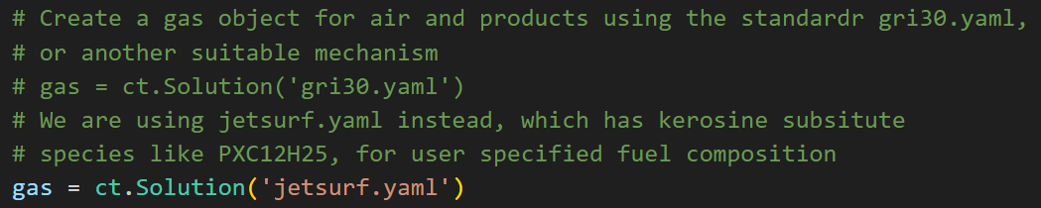
Cantera library
Software implementation
Open-source suite of tools for problems involving chemical kinetics, thermodynamics, and transport processes
https://cantera.org/index.html
Jetsurf machanism used for
Gas path transport
Compression/expansion
Combustion
https://web.stanford.edu/group/haiwanglab/JetSurF/JetSurF2.0/Index.html

Slide 24
Using Cantera (ct) gas model
Software implementation
define gas model
gas = ct.Solution('jetsurf.yaml’)
Set T, P, composition (mass mixing ratios)
gas.TPY = 1200, 101325, 'CH4:1, O2:2, N2:7.52’
Get T or P
P = gas.P
T = gas.T

Slide 25
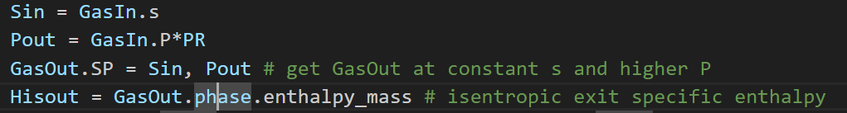
Using Cantera (ct) mass flow/transport
Software implementation
Define a quantity (mass flow) of gas
GasIn = ct.Quantity(gas, mass flow)
Set mass flow entropy or enthalpy and pressure
GasIn.SP = entropy value, pressure value
GasIn.HP = enthalpy value, pressure value
Isentropic compression of GasIn mass flow (with pressure ratio PR)

Slide 26
Using Cantera (ct) combustion
Software implementation
2 options for fuel specification
User specified composition (single species)
T and P
or
User specified LHV (mix of ‘unknown’ species, e.g. Kerosine, Jet-A)
T and P
average H/C and O/C ratio of the fuel molecules
In both cases end H, T, P and composition can be calculated

Slide 27
User specified fuel composition
Cantera - combustion
fuel = ct.Quantity(fg.gas) define fuel
fuel.mass = fuel mass flow fuel.TPY = T, P, FuelComposition define T, P, composition
GasOut = GasIn + fuel mix fuel with air
GasOut.equilibrate('HP’) chemical equilibrium combustion end state
T4 = GasOut.T get combustion end T (or H, S etc)

Slide 28
User specified LHV
Cantera - combustion
More complicated
Cannot use Equilibrate function
Need to calculate end composition from
Air composition
Fuel H/C and O/C ratios
Mole fractions book keeping (converting between mass – moles)

Slide 29
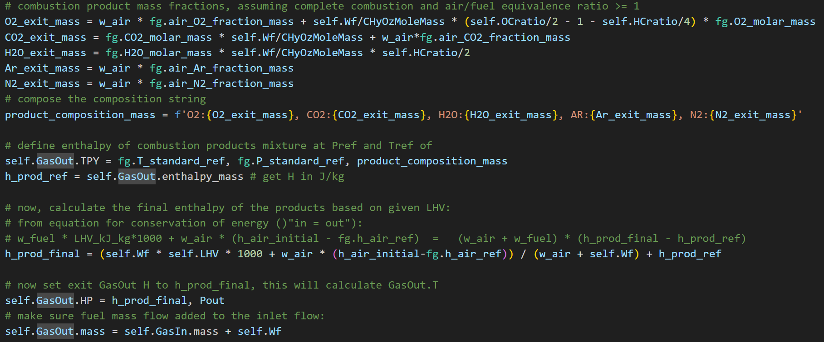
User specified LHV code
Cantera - combustion
Little bit more code lines:

Slide 30
Numpy and Scipy
Software implementation
https://docs.scipy.org/doc/
Numpy
multidimensional array operations
Scipy
solving system model non-linear algebraic/differential equations
using Root function
finding root of a vector function
> a valid system steady-state or transient point
newton-Raphson like iteration
several solver methods
Most suitable solver method ‘Krylov’

Slide 31
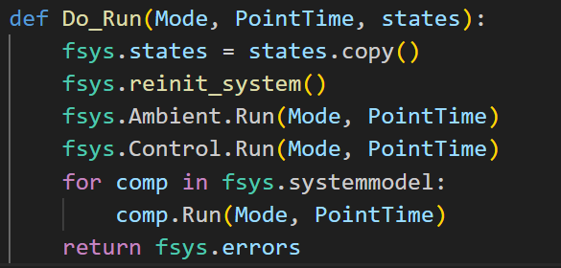
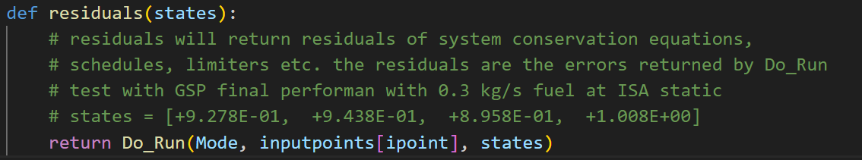
Solver code
Software implementation
Do_Run runs all component model code and returns the vector of equation errors (residuals)
residuals is the vector function (returns all 0’s if states is valid OP)
fsys.states = the initial value of the state vector
solution = the state vector representing a valid operating point

Slide 32
Component model implementations
Software implementation
Inlets
Turbo machinery
Implementation of component performance maps
Compressors
Fans
Combustors
Ducts
Exhaust nozzles and diffusers

Slide 33
Inlets
Component model implementations

Slide 34
Compressors

Slide 35
Python implementation - output
Software implementation
Generate global output table pandas
Code output per component
System level output (PW, FN, Wf, W2 etc.)
Export to .csv
Make graphs in Excel
Component maps
Graphical output matplotlib
Compessors, fans, turbines, …
Draw operating lines in maps
scaling

Slide 36
Object orientation
Software implementation
3 main paradigms
Encapsulation
An object holds both data and ‘methods’ (procedures, functions) working with these and data, and also external data
Object class (class is ‘type’ of object)
Inheritance
An object can inherit data and methods from a ‘parent class’
Polymorphism
An object variable can represent objects from different classes inheriting from the same parent

Slide 37
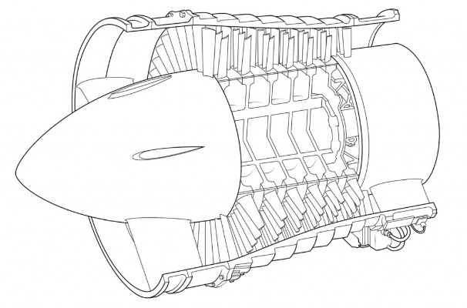
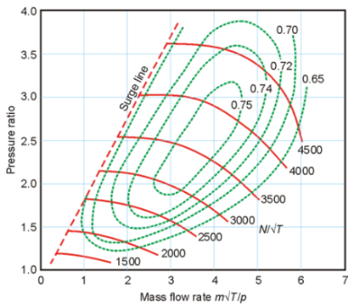
Encapsulation example
Software implementation
Compressor component model
compressor object class holds
W, PR, Eta, N
methods to calculate the compression process
Compressor performance map
Functions to communicate with the system model and other component models

Slide 38
Inheritance example
Gas path W, T, P in/out
Inlet
Turbomachinery N, PR, Eta, PW
Controls
Fuel control
Duct
Combustor fuel flow
….
Compressor compression
Turbine expansion
Fan splitter
….
Exhaust PR, thrust
instantiable class
abstract class
Generic component model class
Software implementation
legend
data
functions, procedures (algorithms)

Slide 39
Polymorphism example
Software implementation
Generic component model class object
‘abstract’ object that can represent any child object
has a generic ‘Run’ method (procedure or function)
Child classes inherit and ‘override’ the Run procedure with calculations actually simulating the process in the component
System model
List of objects (of instantiable classes)
E.g. Inlet-compressor-combustor-turbine-exhaust
System model simulation subsequently calls the ‘Run’ methods of all objects in the list, in this example calculating from inlet through exhaust….
Abstract Generic component model class
Encapsulation
An object holds both data and ‘methods’ (procedures, functions) working with these and data, and also external data
Object class (class is ‘type’ of object)
Inheritance
An object can inherit data and methods from a ‘parent class’
Polymorphism
An object variable can represent objects from different classes inheriting from the same parent

Slide 40
Polymorphism python code example
Software implementation
# create a turbojet model list of component models
turbojet = [TInlet( 'Inlet1', 19.9, 1 ),
TCompressor('compressor1', 1, 16540, 6.92, 0.825),
TCombustor( 'combustor1', 0.38, 0, 1, 1 ),
TTurbine( 'turbine1', 1, 16540, 0.88 ),
TDuct( 'exhaustduct', 1 ),
TExhaust( 'exhaust1', 1, 1, 1 )]
……
# comp is the abstract component object
for comp in turbojet:
q_gas = comp.Run(Mode, q_gas, Ambient)
Class
Name
Design/object data

Slide 41
Adapting the baseline code
Software implementation
Other engine configurations
Turbofan
Mixer
Recuperator / heat exchanger
Turbogenerator
Add propulsion system elements
Generators, electric motors, propulsors, batteries, fuel cells

Slide 42
Adapting the baseline code
Software implementation
Component model extensions
Variable geometry
Bleed
Turbine cooling
1-D model code
Other fuels
Easily adapt fuel in combustor component (cantera)
…

Slide 43
Adapting the baseline code
Software implementation
API (Application Programming Interface)
Couple with other models
Extend user interface
Extend output
Graphs, tables, export
Add GUI

Slide 44
Main program code
Software implementation
# Generic gas turbine components
inlet1 = TInlet('Inlet1', '', 0,2, 19.9, 1 )
duct1 = TDuct('exhduct', '', 5,7, 1.0 )
exhaust1 = TExhaust('exhaust1', '', 7,8,9, 1, 1, 1, 1 )
# ***************** Combustor ******************************************************
# fuel input
combustor1 = TCombustor('combustor1', '', 3, 4, 0.38, None, 1, 1, None, 43031, 1.9167, 0, '')
compressor1 = TCompressor('compressor1','compmap.map' , 2, 3, 1, 16540, 0.825, 1, 0.75 , 6.92, 'GG')
turbine1 = TTurbine( 'turbine1' ,'turbimap.map', 4, 5, 1, 16540, 0.88 , 1, 0.50943, 0.99, 'GG’)
fsys.systemmodel = [inlet1,
compressor1,
combustor1,
turbine1,
duct1,
exhaust1]

Slide 45
Relationships among component models
Software implementation
Ambient
Inlet, exhausts
Gas path
Gas conditions and flow rates between two connected components
Engine station numbering
Example: compressor – combustor, station nr. 3
Shafts
Power balance PW_{compressor} = PW_{turbine}
If no balance: transient (accel or decel)
Heat transfer
Control
Fuel flow, variable geometry

Slide 46
Passing gas conditions in Python
Software implementation
# use dictionary for gas path conditions oriented by gas path station number
gaspath_conditions = {}
def Run(self, Mode, PointTime):
…
self.GasIn = fsys.gaspath_conditions[self.stationin]
…
# Calculate self.GasOut
…
fsys.gaspath_conditions[self.stationout] = self.GasOut
return self.GasOut

Slide 47
Extending the models - 1
Software implementation
Fidelity
1-D component models
Turbomachinery
Combustors
Couple with multi-D CFD models
Gas turbine system
Control system
Fans, mixers
Recuperators

Slide 48
Extending the models - 2
Software implementation
Propulsion system elements
Loads (propellers, generators)
Hybrid propulsion systems
Batteries
Fuel cells

Slide 49
Conclusion

Slide 50
Questions?

Slide 51
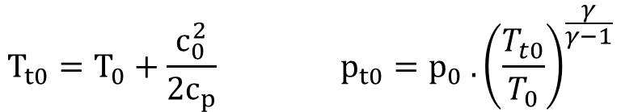

Aero engine inlet ram compression
Jet engine inlet example
internal diffusion (compression)
external diffusion (compression)
2
0
1
$$Ram recovery factor RR=\frac{p_{t2}}{p_{t0}}$$
“inlet efficiency”
$$T_{t0}=T_{0}+\frac{c_{0}^{2}}{2c_{p}} p_{t0}=p_{0} . {\left(\frac{T_{t0}}{T_{0}}\right)}^{\frac{γ}{γ−1}}$$

Slide 52
T-S diagram, turbojet REAL cycle
C₀ = air speed
C₈ = propelling jet velocity
pressure loss
4
turbine
5
T
c₈²
p₀
nozzle
3
2c_{p}
station 1 = inlet front
1-2 : inlet losses
8
c₀²
2
2c_{p}
1
0
S

Slide 53
T-S diagram, afterburning turbojet (reheat)
C₀ = air speed
C₈ = propelling jet velocity
pressure loss
c₈²
4
afterburner
2c_{p}
nozzle
turbine
T
8 (9 with con-di nozzle)
5
p₀
3
c₀²
2
2c_{p}
1
0
S

Slide 54
T-S diagram, turbofan REAL cycle
unmixed turbofan
C₀ = air speed
C₈ = propelling jet velocity
pressure loss
4
HP turbine
45
LP turbine
T
c₈²
5
p₀
3
2c_{p}
hot nozzle expansion
cold nozzle expansion
8
25
c₀²
2
2c_{p}
1
0
S

Slide 55
Dimensionless groups
D
P₀₂, T₀₂
P₀₁, T₀₁
N
Turbomachinery
Compressors, Fans, Turbines
(propellers, helicopter rotors)
Performance representation (ideal gas)
‘Function’ of D, N, m, P₀₁, P₀₂, T₀₁, T₀₂, ν (or μ), γ (c_{p}/c_{v})
Dimensional analysis (Pi theorem):
3 fundamental units present (M, T, L)
Number of variables reducible by 3 into 9-3 = 6 non-dim. groups
Relations among which describe performance
4 primary groups
2 groups often ignored for gas turbines
effect viscosity ν or μ (Re) marginal on efficiency, ‘only’ high altitude
Gamma γ only if using different media (e.g. process industry, organic rankine, scCO2 cycles) or large temperature changes (γ = F(T))
m
γ, μ

Slide 56
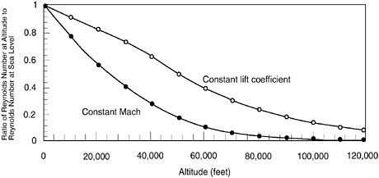
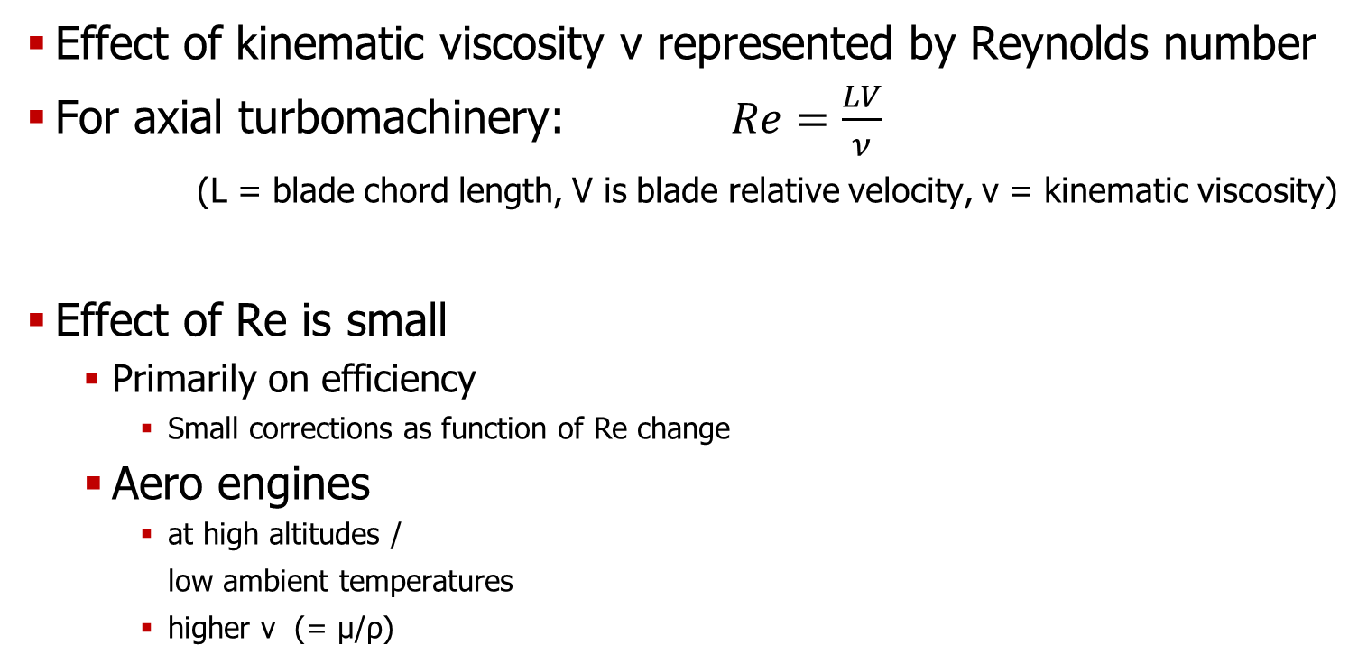
Dimensionless groups - Reynolds
Effect of kinematic viscosity ν represented by Reynolds number
For axial turbomachinery: $Re=\frac{LV}{ν}$
(L = blade chord length, V is blade relative velocity, ν = kinematic viscosity)
Effect of Re is small
Primarily on efficiency
Small corrections as function of Re change
Aero engines
at high altitudes / low ambient temperatures
higher ν (= μ/ρ)

Slide 57
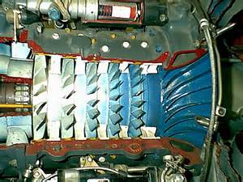
Compressor characteristics
p
Surge line
0,3
p
0,2
A
Equilibrium running line
N
curves of constant
η
√θ
comp
m
√θ
δ

Slide 58
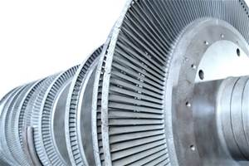
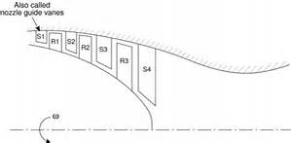
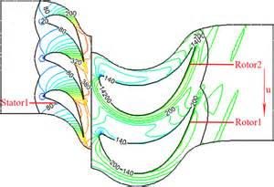
Turbine characteristics
η
turb
N
√θ
m
√θ
choking
δ
N
√θ
PR =p
/
p
0,4
0,5

Slide 59
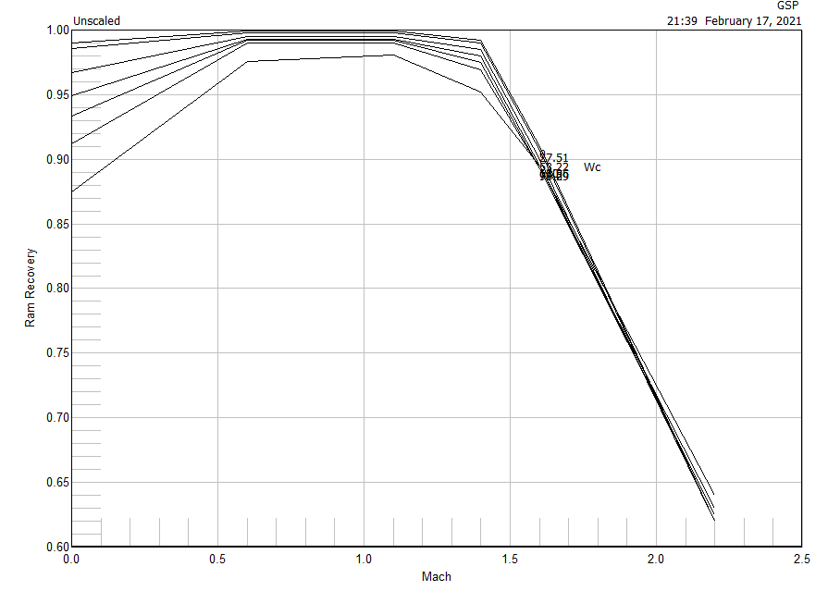
Inlet characteristics
Pressure loss function
‘Ram recovery’ RR = PT2/PT0 = F(Wc2, Mach,..)
Civil turbofans : RR > 0.95
Military

Slide 60
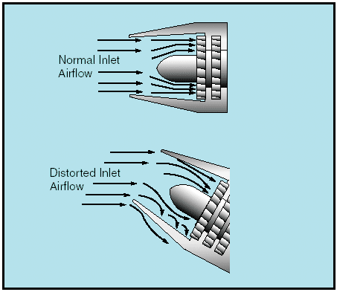
Inlet flow distortion
Cross wind

Slide 61
Inlet efficiency (2)
Engineering practice
no isentropic efficiency
Instead represent losses using
RR Ram recovery factor = Pt2/Pt0 ~ 0.6? - 0.97
F16 Inlet RR = ~ 0.98 @ cruise
F16 Inlet RR = ~ 0.89 @ MIL Take-off V=0 !

Slide 62
Jet engine exhaust nozzle
expansion (conversion of E_{pot} (pressure) to E_{kin})
subsonic & supersonic
geometry
losses
shock waves
cold (turbofan) versus hot exhaust
mixed flow
thrust reversing

Slide 63
Exhaust nozzles
Small pressure loss
Wc
Choking Ma> = 1 PR ~ 1.9
PR (Ptin / Po)

Slide 64
Nozzle efficiency (3)
Engineering practice
no isentropic efficiency
Instead represent losses using
CD discharge coefficient = A_{eff}/A_{geom} ~ 0.95-0.97
CV velocity coefficient = C_{j}/C_{jdeal} ~ 0.95-0.98
CX thrust coefficient = FG/FG_{ideal} ~ 0.95-0.98
CV ~ CX represent similar loss

Slide 65
Critical pressure ratio
p
p
res
omg
amb
p
const
amb
= konst
amb
m
p
const
= konst
res
ε_{cr}
p
/p
g
omg
kr
res
amb

Slide 66
Isentropic expansion

Slide 67
Nozzle area and Mach number
ρ
ρ
throat

Slide 68
Non-isentropic expansion
M=1

Slide 69
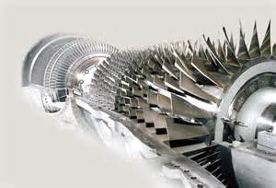
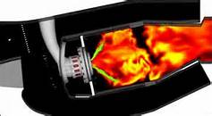

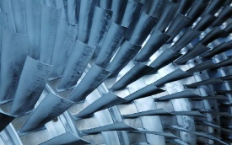
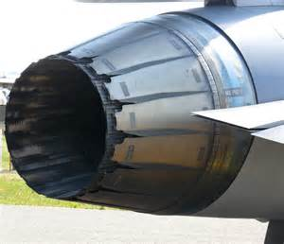
Gas turbine system performance
Component characteristics
intake, fans/compressors
combustion chambers, turbines, mixers, exhausts
limits (stall, rotational speeds, temperatures....)
Engine Characteristics
gas turbine system: Rotor speeds, FN, PW, TRQ, WF, SFC, etc.
steady-state vs. transient
Power Limitations
limits: temperature, pressure, rotor speeds, stall, ....

Slide 70
Complete expansion
Calculation recipe for unchoked nozzle (complete expansion to p₀ at nozzle throat or nozzle exit)

Slide 71
Incomplete expansion
Calculation recipe for choked nozzle (incomplete expansion to p_{j} at nozzle throat, residual expansion beyond throat)
solve for c_{eff}

Slide 72
Converging vs. Converging-diverging
“Convergent vs. ‘Con-Di’ nozzle”
Difference in design thrust
Nozzle pressure ratio
Application (e.g., F-16)
Off-design performance
Relation thrust ↔ drag
Weight, length, etc.

Slide 73
TJET turbine performance in GSP

Slide 74
Other components performance characteristics
Ducts
Pressure loss function of flow (Wc) or Mach or other
Inlets
Simular to ducts
Also function of flight conditions (Ma_{flight} )
Heat loss effects
All components
Heat transfer models
Other components
Specific effects on gas path

Slide 75
Gas turbine (‘whole engine’) characteristics
Equilibrium running lines in component characteristics
p
0,3
p
0,2
T
0,4
T
0,2
N
√ T
0,2
m
√ T
0,2
p
0,2

Slide 76
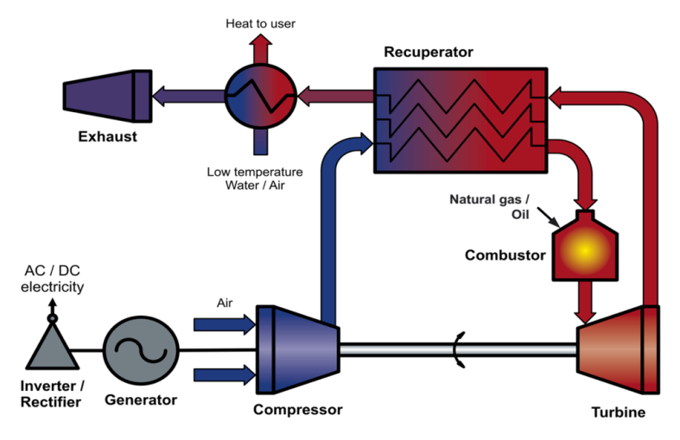
Recuperation
Transfer exhaust heat to preheat combustor flow
Saving fuel
Adds substantial mass and volume to the gas turbine system
Expensive
Tough recuperator heat exchanger design requirements
High manufacturing costs
Aero engine application
Topic of research
So far, high mass and volume too high
Additional reliability and safety issues

Slide 77
Power limitation
p
2
(max. internal pressure)
N
Shaft power or Thrust
2
(HD-shaft)
T
0,3
-40
-30
-20
-10
0
10
20
30
40
ISA
Ambient temperature sea level
“Flat rating” = FN, Power/TRQ limitation at low T_{0,2}

Slide 78
Performance limitations
limits: temperature, pressure, rotational speed, stall, ....
steady-state
variation T₀ ➔
variation P₀
acceleration
deceleration
control
p
0,3
T
p
0,4
0,2
T
O
0,2
A
B
equilibrium running line
N
√ T
0,2
m
√ T
0,2
p
0,2

Slide 79
AE4263 Modeling, Simulation and Application of Power and Propulsion Systems
Lectures + work shop 2nd semester 3+2 ECTS
Performance prediction of gas turbine engines
aero engines (AE)
industrial engines (3mE)
Understand/analyze engine behaviour
Design point and off-design
Gas turbine Simulation Program GSP (www.gspteam.com)
https://online-learning.tudelft.nl/courses/modeling-simulation-and-application-of-power-and-propulsion-systems/
https://brightspace.tudelft.nl/d2l/home/45948

